Slide 1
Weapon Stats List

Slide 2
Zombies
There will be a variety of zombies that when damaged enough by weapons, will fall to the ground and be susceptible to being run over by the mower and finally killed. There will be two variations of two different kinds of zombies : the regular zombie and the short zombie
Regular zombie will have more health but the short zombie will be quicker. The stronger variations will have more health and do more damage.

Slide 3
Mower
The vehicle the main character will be riding on and upgrading throughout the course of the game. The player will have the ability to purchase upgrades from the store using currency obtained from fallen zombies.
When a zombie takes enough damage from the mower than it will fall over. If the mower collides with a zombie and it doesn’t fall over, than the mower will take 5 damage and stop in its tracks.
Health: 100
Collision Damage against zombies: 30

Slide 4
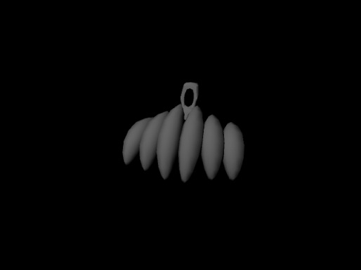
Battering Ram
Battering Ram provides the mower with extra damage and health against the zombies it collides with. When the Ram loses all of its hit points, it falls off and the mower returns to its default damage.
Default Mower Health: 100 Health
Default Mower collision damage: 30 Damage
Battering Ram Health: 50 Health
Battering Ram Damage: +50 Damage when collision with zombies

Slide 5
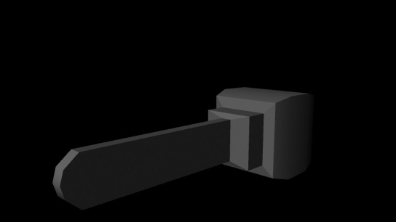
Chainsaw
Chainsaw provides the mower with a close ranged melee attack that deals massive damage but burns through gasoline quickly.
40 damage/second
Ammo( gasoline ): 30
Ammo consumption: 1 ammo/second
Range: Very Close

Slide 6
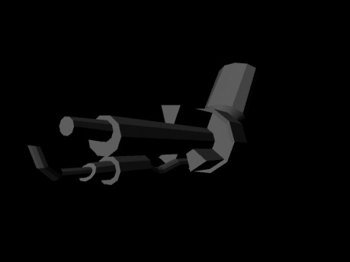
Flame Thrower
Provides the mower with a medium range fire attack that damages zombies over time. Ammo consumption is high.
20 Damage/second from the immediate flames.
5 damage/second from fire if flames collide with enemy.
Ammo: 20
Ammo Consumption: 1/sec
Range: Medium

Slide 7
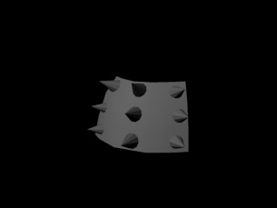
Shield
Provides your mower with a significant health upgrade and damage reduction
Health: 100(default) + 50(from shield)
Damage Reduction: 20% damage reduction

Slide 8
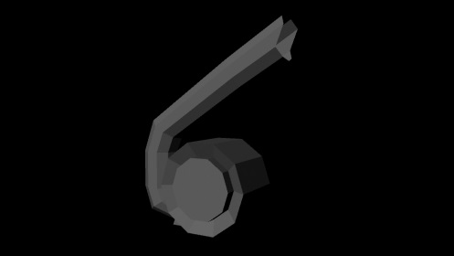
Leaf Blower Launcher
Provides the mower with a long range explosive projectile launching device (or Leaf Blower). This device will shoot explosive grenades in an arc and they will explode on impact with the ground/zombie it collides with.
Damage: 50 damage per grenade
5 Ft explosive radius
15 Ft launch distance
Range: Long
Fire Rate: slow

Slide 9
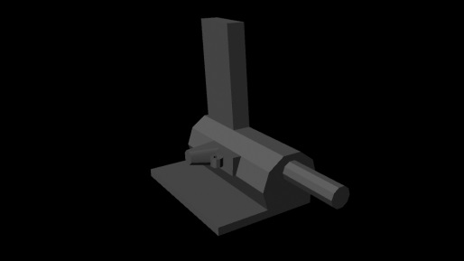
Nail Gun
The nail gun provides the mower with a long range, light damage weapon. This weapon will root the zombies to the ground and allow the player to easily run them over without taking damage.
Damage: 20 Damage per Nail
Ammo: 50
Long Range
Medium fire rate

Slide 10
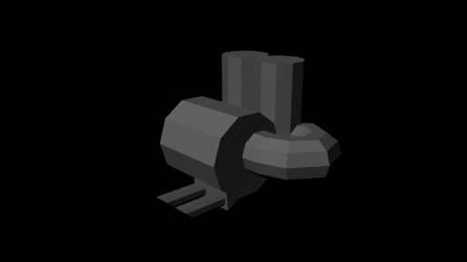
Oil Tank
Provides the mower with a special ability that spews oil onto the ground that causes zombies to slip and fall to the ground for 5 seconds. (VERY OPTIONAL LOTS OF PROGRAMMING REQUIRED: maybe the oil on the ground can be ignited by the flame thrower and cause a circle of fire (5 damage/sec))
Zombies that slip and fall take 10 damage cause why not?

Slide 11
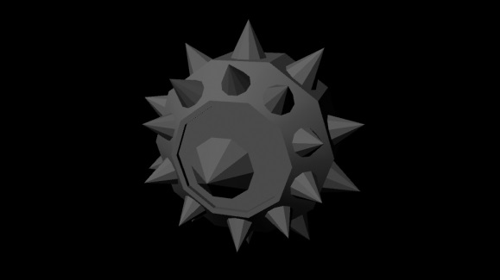
Spiked Wheels
The wheel upgrade gives the mower a number of increased stats.
Speed: +20%
Collision: +20 damage

